Slide 1
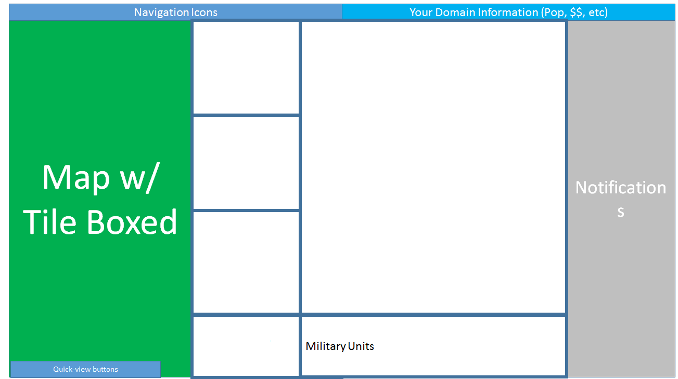
<Type>
<Description> <Domain> <Owner>
Categories
Buildings in Category w/ Icon
<Type>
<Description> Worked By:
Type1
Type2
Type3
Icon List
Icon List
Icon List
…
ListBox
Go!
<Type>
<Description> Worked By:
ListBox
<Type>
<Description>

